Slide 1

Extending the multilevel model for change
ALDA, Chapter Five
“Change is a measure of time”
Edwin Way Teale
John B. Willett & Judith D. Singer
Harvard Graduate School of Education

Slide 2



Chapter 5: Treating TIME more flexibly
General idea: Although all our examples have been equally spaced, time-structured, and fully balanced, the multilevel model for change is actually far more flexible
Variably spaced measurement occasions (§5.1)—each individual can have his or her own customized data collection schedule
Varying numbers of waves of data (§5.2)—not everyone need have the same number of waves of data
  Allows us to handle missing data
  Can even include individuals with just one or two waves
Including time-varying predictors (§5.3)
  The values of some predictors vary over time
  They’re easy to include and can have powerful interpretations
Re-centering the effect of TIME (§5.4)
  Initial status is not the only centering constant for TIME
  Recentering TIME in the level-1 model improves interpretation in the level-2 model
© Singer & Willett, page <number>

Slide 3



Example for handling variably spaced waves: Reading achievement over time
Data source: Children of the National Longitudinal Survey of Youth (CNLSY)
Sample: 89 children
  Each approximately 6 years old at study start
Research design
  3 waves of data collected in 1986, 1988, and 1990, when the children were to be “in their 6th yr,” “in their 8th yr,” and “in their 10th yr”
  Of course, not each child was tested on his/her birthday or half-birthday, which creates the variably spaced waves
  The outcome, PIAT, is the child’s unstandardized score on the reading portion of the Peabody Individual Achievement Test
    Not standardized for age so we can see growth over time
  No substantive predictors to keep the example simple
Research question
  How do PIAT scores change over time?
© Singer & Willett, page <number>

Slide 4
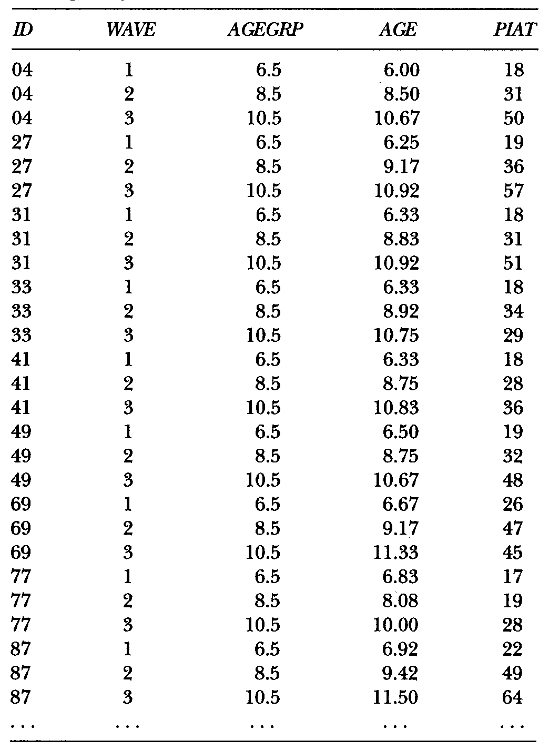
What does the person-period data set look like when waves are variably spaced?
Person-period data sets are easy to construct even with variably spaced waves
We could build models of PIAT scores over time using ANY of these 3 measures for TIME—so which should we use?
Three different ways of coding TIME
WAVE—reflects design but has no substantive meaning
AGEGRP—child’s “expected” age on each occasion
AGE—child’s actual age (to the day) on each occasion—notice “occasion creep”—later waves are more likely to be even later in a child’s life
(ALDA, Section 5.1.1, pp 139-144)
© Singer & Willett, page <number>

Slide 5
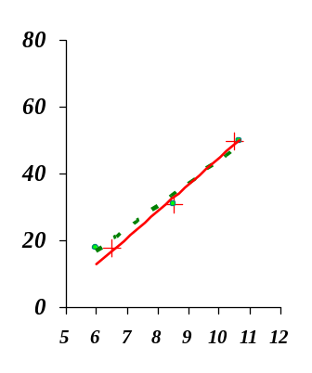
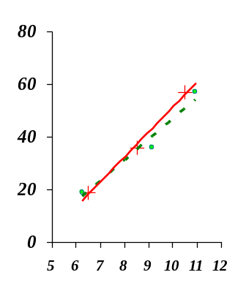
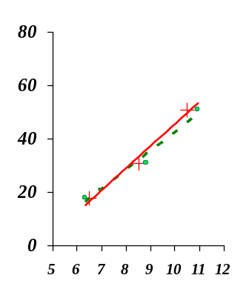

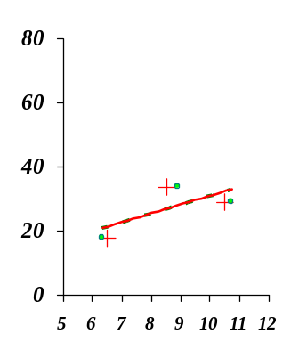
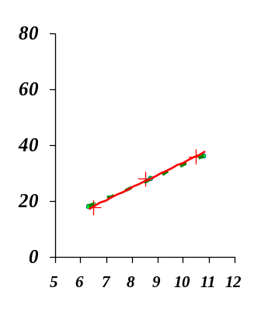
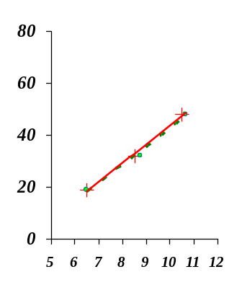
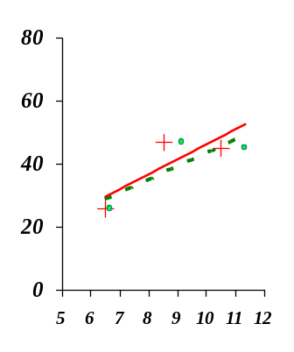
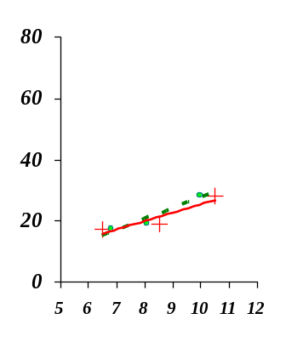
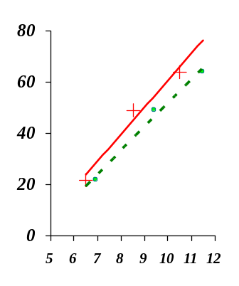
Comparing OLS trajectories fit using AGEGRP and AGE
AGEGRP
(+’s with solid line)
For many children—especially those assessed near the half-years—it makes little difference
AGE
(•’s with dashed line)
Why ever use rounded AGE?
Note that this what we did in the past two examples, and so do lots of researchers!!!
For some children though—there’s a big difference in slope, which is our conceptual outcome (rate of change)
(ALDA, Figure 5.1 p. 143)
© Singer & Willett, page <number>

Slide 6
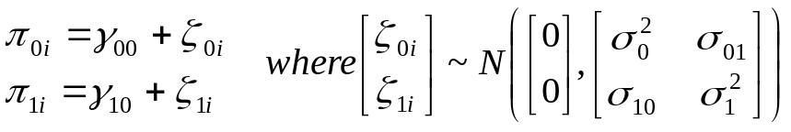
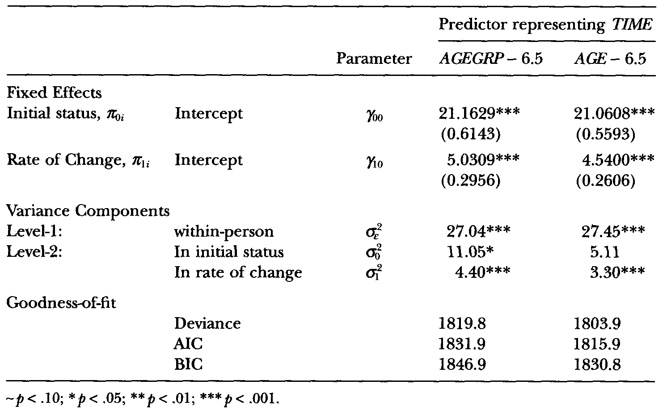

Comparing models fit with AGEGRP and AGE
Level-1 Model:
By writing the level-1 model using the generic predictor TIME, the specification is identical
Level-2 Model:
Composite Model:
Some parameter estimates are virtually identical
Other est’s larger with AGEGRP
, the slope, is ½ pt larger
cumulates to a 2 pt diff over 4 yrs
Level-2 VCs are also larger
AGEGRP associates the data from later waves with earlier ages than observed, making the slope steeper
Unexplained variation for initial status is associated with real AGE
AIC and BIC better with AGE
Treating an unstructured data set as structured introduces error into the analysis
(ALDA, Section 5.1.2, pp 144-146)
© Singer & Willett, page <number>

Slide 7


Example for handling varying numbers of waves: Wages of HS dropouts
Data source: Murnane, Boudett and Willett (1999), Evaluation Review
Sample: 888 male high school dropouts
  Based on the National Longitudinal Survey of Youth (NLSY)
  Tracked from first job since HS dropout, when the men varied in age from 14 to 17
Research design
  Each interviewed between 1 and 13 times
    Interviews were approximately annual, but some were every 2 years
    Each wave’s interview conducted at different times during the year
  Both variable number and spacing of waves
  Outcome is log(WAGES), inflation adjusted natural logarithm of hourly wage
Research question
  How do log(WAGES) change over time?
  Do the wage trajectories differ by ethnicity and highest grade completed?
© Singer & Willett, page <number>

Slide 8
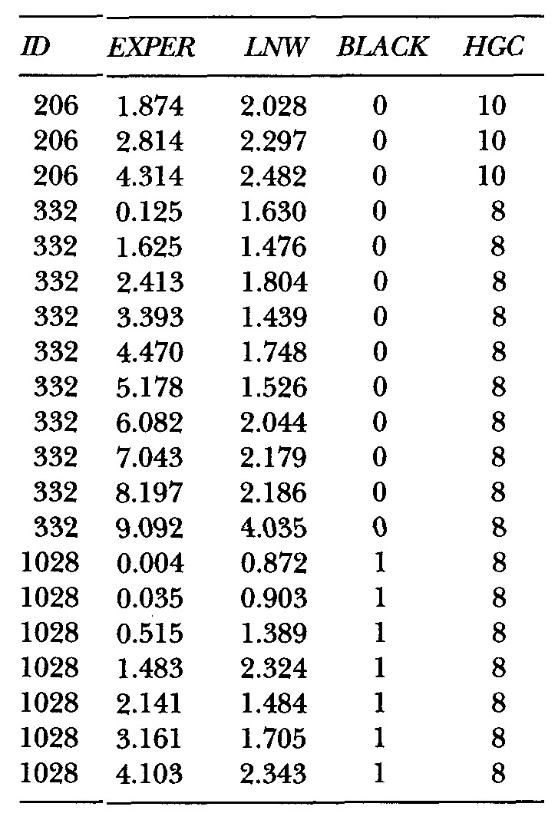
Examining a person-period data set with varying numbers of waves of data per person
ID 206 has 3 waves
# waves | N men
1 | 38
2 | 39
3-4 | 82
5-6 | 166
7-8 | 226
9-10 | 240
>10 | 97
ID 332 has 10 waves
ID 1028 has 7 waves
EXPER = specific moment (to the nearest day) in each man’s labor force history
Varying # of waves
Varying spacing
Covariates:
Race and Highest Grade Completed
LNW in constant dollars seems to rise over time
(ALDA, Section 5.2.1, pp 146-148)
© Singer & Willett, page <number>

Slide 9
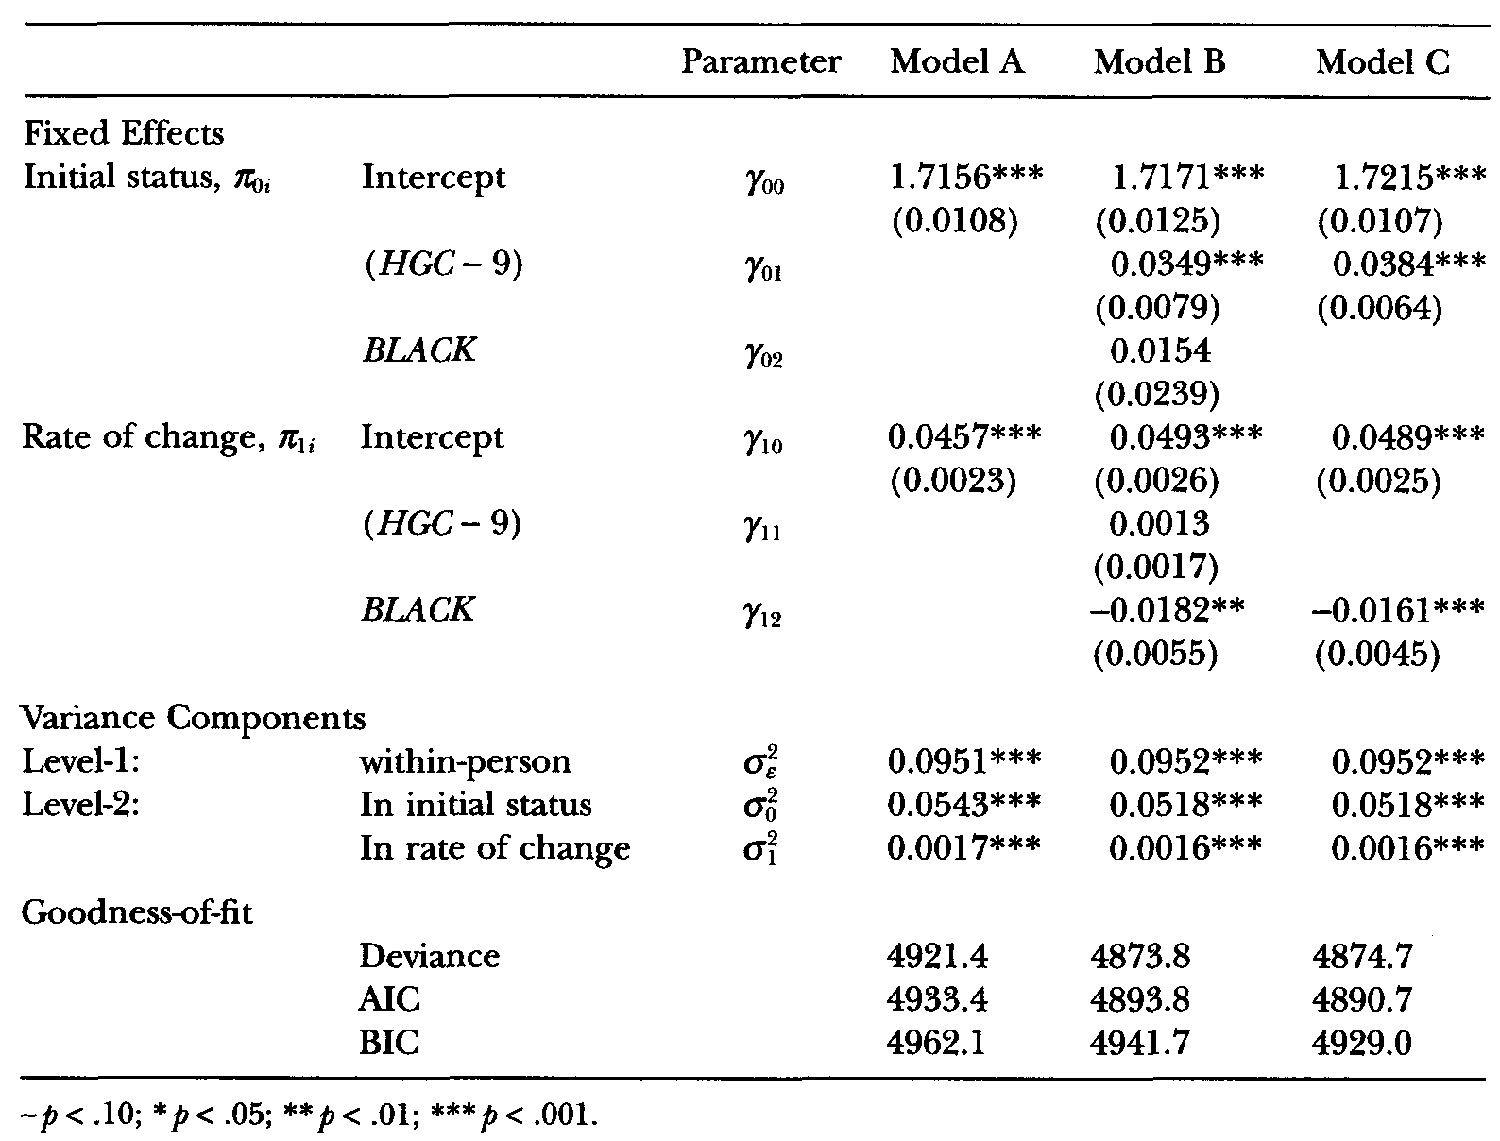
Fitting multilevel models for change when data sets have varying numbers of waves
Everything remains the same—there’s really no difference!
Unconditional growth model: On average, a dropout’s hourly wage increases with work experience
100(e^{(0.0457)}-1)=4.7 is the %age change in Y per annum
Model C: an intermediate “final” model
Almost identical Deviance as Model B
Effect of HGC—dropouts who stay in school longer earn higher wages on labor force entry (~4% higher per yr of school)
Effect of BLACK—in contrast to Whites and Latinos, the wage of Black males increase less rapidly with labor force experience
  Rate of change for Whites and Latinos is 100(e^{0.489}-1)=5.0%
  Rate of change for Blacks is 100(e^{0.489-0.0161}-1)=3.3%
Significant level-2 VCs indicate that there’s still unexplained variation—this is hardly a ‘final’ model
Fully specified growth model (both HGC & BLACK)
HGC is associated with initial status (but not change)
BLACK is associated with change (but not initial status)
⇒ Fit Model C, which removes non-significant parameters
(ALDA, Table 5.4 p. 149)
© Singer & Willett, page <number>

Slide 10
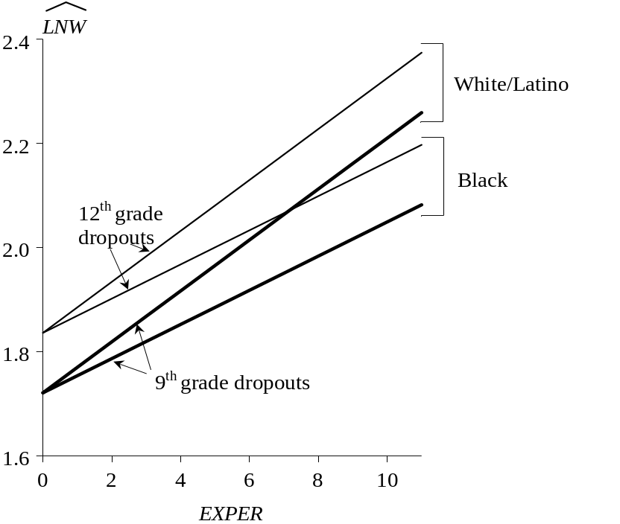
Prototypical wage trajectories of HS dropouts
Race
At dropout, no racial differences in wages
Racial disparities increase over time because wages for Blacks increase at a slower rate
Highest grade completed
Those who stay in school longer have higher initial wages
This differential remains constant over time (lines remain parallel)
(ALDA, Section 5.2.1 and 5.2.2, pp150-156)
© Singer & Willett, page <number>

Slide 11

Practical advice: Problems can arise when analyzing unbalanced data sets
The multilevel model for change is designed to handle unbalanced data sets, and in most circumstances, it does its job well, however…
When imbalance is severe, or lots of people have just 1 or 2 waves of data, problems can occur
  You may not estimate some parameters (well)
  Iterative fitting algorithms may not converge
  Some estimates may hit boundary constraints
  Problem is usually manifested via VCs not fixed effects (because the fixed portion of the model is like a ‘regular regression model”).
 Software packages may not issue clear warning signs
  If you’re lucky, you’ll get negative variance components
  Another sign is too much time to convergence (or no convergence)
  Most common problem: your model is overspecified
  Most common solution: simplify the model
Many practical strategies discussed in ALDA, Section 5.2.2
Another major advantage of the multilevel model for change: How easy it is to include time-varying predictors
(ALDA, Section 5.2.2, pp151-156)
© Singer & Willett, page <number>

Slide 12
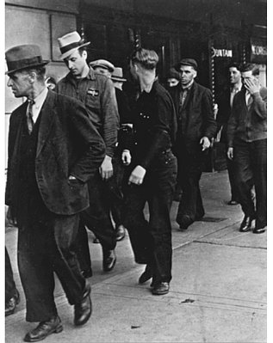

Example for illustrating time-varying predictors: Unemployment & depression
Source: Liz Ginexi and colleagues (2000), J of Occupational Health Psychology
Sample: 254 people identified at unemployment offices.
Research design: Goal was to collect 3 waves of data per person at 1, 5 and 11 months of job loss. In reality, however, data set is not time-structured:
    Interview 1 was within 1 day and 2 months of job loss
    Interview 2 was between 3 and 8 months of job loss
    Interview 3 was between 10 and 16 months of job loss
    In addition, not everyone completed the 2nd and 3rd interview.
  Time-varying predictor: Unemployment status (UNEMP)
    132 remained unemployed at every interview
    61 were always working after the 1st interview
    41 were still unemployed at the 2nd interview, but working by the 3rd
    19 were working at the 2nd interview, but were unemployed again by the 3rd
  Outcome: CES-D scale—20 4-pt items (score of 0 to 80)
Research question
  How does unemployment affect depression symptomatology?
(ALDA, Section 5.3..1, pp160-161)
© Singer & Willett, page <number>

Slide 13
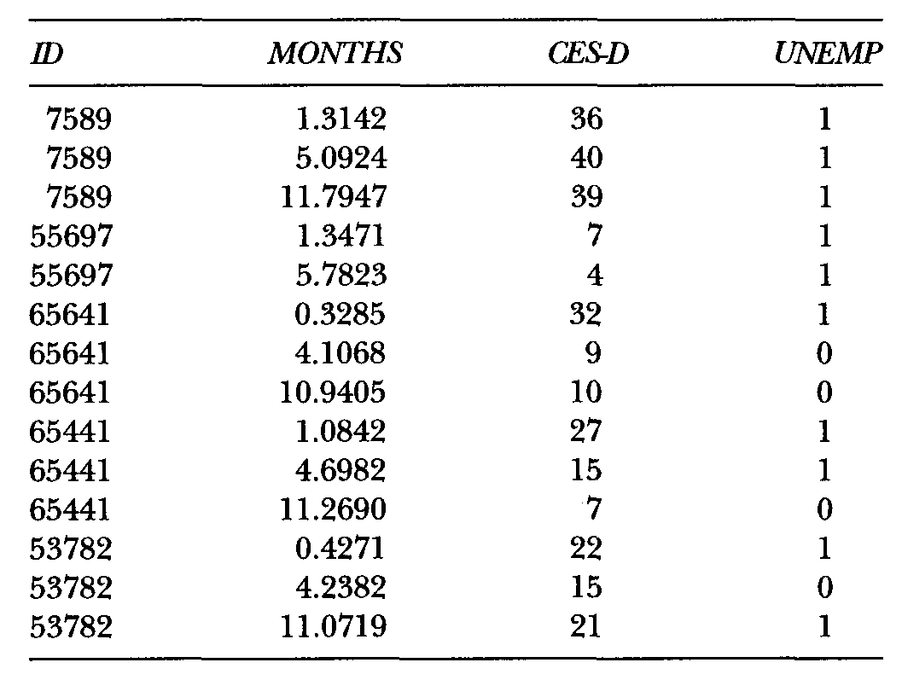
A person-period data set with a time-varying predictor
TIME=MONTHS since job loss
UNEMP (by design, must be 1 at wave 1)
ID 7589 has 3 waves, all unemployed
ID 65641 has 3 waves,
re-employed after 1st wave
ID 53782 has 3 waves, re-employed at 2nd, unemployed again at 3rd
(ALDA, Table 5.6, p161)
© Singer & Willett, page <number>

Slide 14
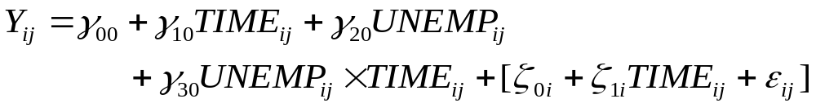
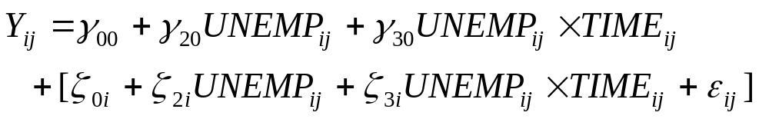
Analytic approach: We’re going to sequentially fit 4 increasingly complex models
Goal is to both explain the use of TV predictors and illustrate how you do practical data analysis
Model A: An individual growth model with no substantive predictors
Model B: Adding the main effect of UNEMP
Model C: Allowing the effect of UNEMP to vary over TIME
Model D: Also allows the effect of UNEMP to vary over TIME, but does so in a very particular way
(ALDA, Section 5.3.1, pp 159-164)
© Singer & Willett, page <number>

Slide 15
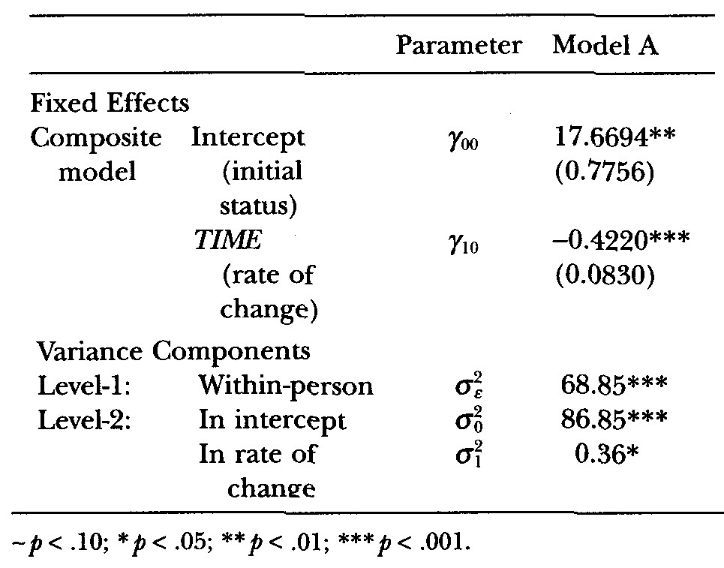
First step: Model A: The unconditional growth model
Let’s get a sense of the data by ignoring UNEMP and fitting the usual unconditional growth model
Level-1 Model:
Level-2 Model:
How can it go at level-2???
Composite Model:
It seems like it can go here
On the first day of job loss, the average person has an estimated CES-D of 17.7
On average, CES-D declines by 0.42/mo
There’s significant residual within-person variation
There’s significant variation in initial status and rates of change
How do we add the time-varying predictor UNEMP?
(ALDA, Section 5.3.1, pp 159-164)
© Singer & Willett, page <number>

Slide 16
Model B: Adding time-varying UNEMP to the composite specification
Logical impossibility
Population average rate of change in CES-D, controlling for UNEMP
Population average difference, over time, in CES-D by UNEMP status
How can we understand this graphically? Although the magnitude of the TV predictor’s effect remains constant, the TV nature of UNEMP implies the existence of many possible population average trajectories, such as:
Remains unemployed
Reemployed at 5 months
Reemployed at 10 months
Reemployed at 5 months
Unemployed again at 10
CES-D
CES-D
CES-D
CES-D
20
20
20
20
15
15
γ₂₀
15
15
γ₂₀
γ₂₀
γ₂₀
10
10
10
10
5
5
5
5
0
2
4
6
8
10
12
0
14
2
4
6
8
10
12
14
0
2
4
6
8
10
12
14
0
2
4
6
8
10
12
Months since job loss
Months since job loss
Months since job loss
Months since job loss
14
What happens when we fit Model B to data?
(ALDA, Section 5.3.1, pp 159-164)
© Singer & Willett, page <number>

Slide 17
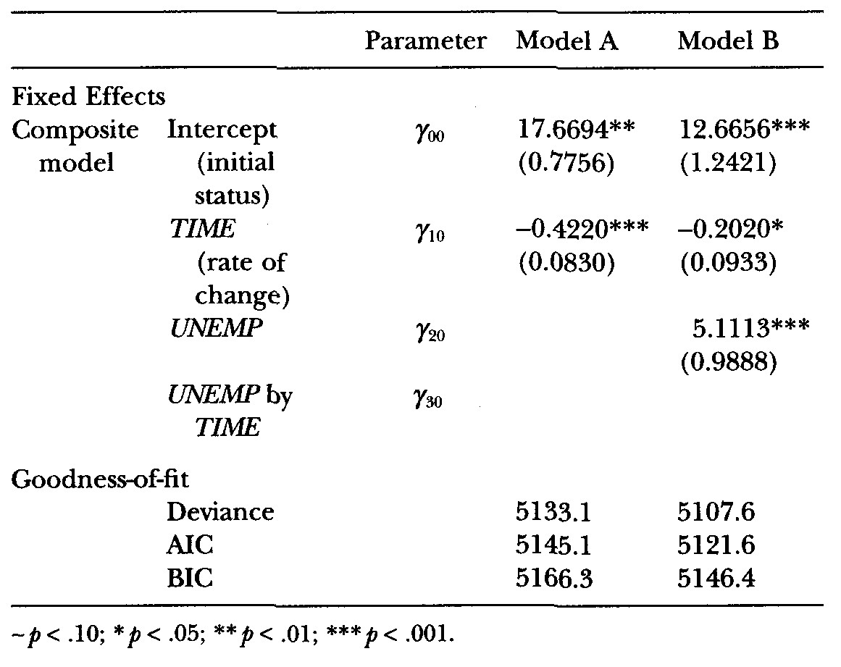
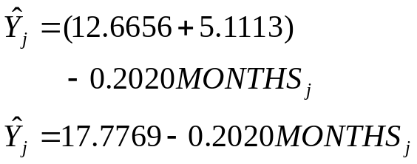

Fitting and interpreting Model B, which includes the TV predictor UNEMP
Monthly rate of decline is cut in half by controlling for UNEMP (still sig.)
UNEMP has a large and stat sig effect
Model A is a much poorer fit (Δ Deviance = 25.5, 1 df, p<.001)
20
CES-D
Consistently unemployed (UNEMP=1):
UNEMP
= 1
15
What about people who get a job?
10
UNEMP
= 0
Consistently employed (UNEMP=0):
What about the variance components?
5
0
2
4
6
8
10
12
14
(ALDA, Section 5.3.1, pp. 162-167)
Months since job loss
© Singer & Willett, page <number>

Slide 18
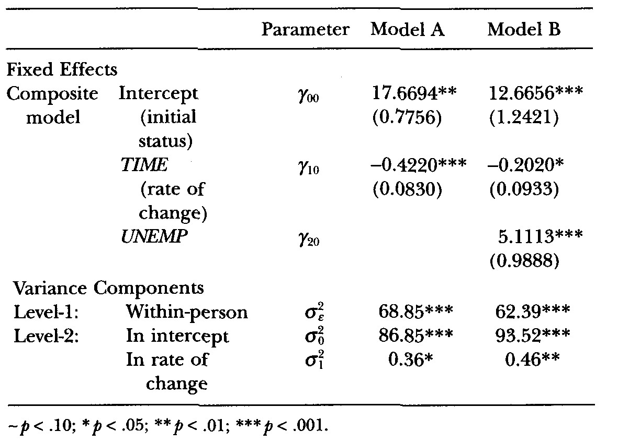


Variance components behave differently when you’re working with TV predictors
When analyzing time-invariant predictors, we know which VCs will change and how:
  Level-1 VCs will remain relatively stable because time-invariant predictors cannot explain much within-person variation
  Level-2 VCs will decline if the time-invariant predictors explain some of the between person variation
When analyzing time-varying predictors, all VCs can change, but
  Although you can interpret a decrease in the magnitude of the Level-1 VCs
   Changes in Level-2 VCs may not be meaningful!
Look what happened to the Level-2 VC’s
In this example, they’ve increased!
Why?: Because including a TV predictor changes the meaning of the individual growth parameters (e.g., the intercept now refers to the value of the outcome when all level-1 predictors, including UNEMP are 0).
Level-1 VC,
Adding UNEMP to the unconditional growth model (A) reduces its magnitude 68.85 to 62.39
UNEMP “explains” 9.4% of the variation in CES-D scores
We can clarify what’s happened by decomposing the composite specification back into a Level 1/Level-2 representation
(ALDA, Section 5.3.1, pp. 162-167)
© Singer & Willett, page <number>

Slide 19
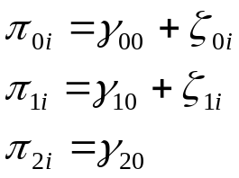
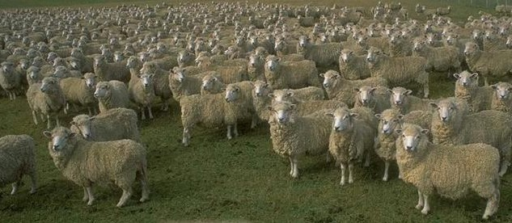
Decomposing the composite specification of Model B into a L1/L2 specification
Level-1 Model:
Unlike time-invariant predictors, TV predictors go into the level-1 model
Level-2 Models:
Model B’s level-2 model for π_{2i} has no residual!
Model B automatically assumes that π_{2i} is “fixed” (that it has the same value for everyone).
Should we accept this constraint?
Should we assume that the effect of the person-specific predictor is constant across people?
When predictors are time-invariant, we have no choice
When predictors are time-varying, we can try to relax this assumption ➢➢
(ALDA, Section 5.3.1, pp. 168-169)
© Singer & Willett, page <number>

Slide 20
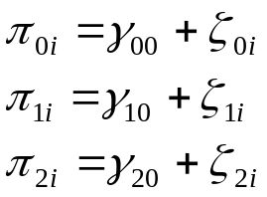
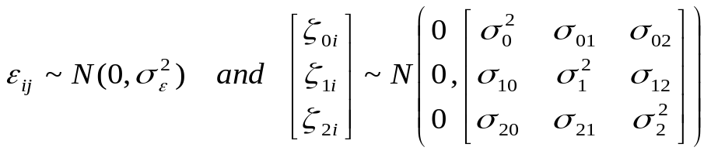

Trying to add back the “missing” level-2 stochastic variation in the effect of UNEMP
Level-1 Model:
It’s easy to allow the effect of UNEMP to vary randomly across people by adding in a level-2 residual
 Check your software to be sure you know what you’re doing….
Level-2 Models:
But, you pay a price you may not be able to afford
Adding this one term adds 3 new VCs
If you have only a few waves, you may not have enough data
Here, we can’t actually fit this model!!
Moral: The multilevel model for change can easily handle TV predictors, but…
Think carefully about the consequences for both the structural and stochastic parts of the model.
Don’t just “buy” the default specification in your software.
Until you’re sure you know what you’re doing, always write out your model before specifying code to a computer package
So…
Are we happy with Model B as the final model???
Is there any other way to allow the effect of UNEMP to vary – if not across people, across TIME?
(ALDA, Section 5.3.1, pp. 169-171)
© Singer & Willett, page <number>

Slide 21

Model C: Might the effect of a TV predictor vary over time?
When analyzing the effects of time-invariant predictors, we automatically allowed predictors to affect the trajectory’s slope
Because of the way in which we’ve constructed the models with TV predictors, we’ve automatically constrained UNEMP to have only a “main effect” influencing just the trajectory’s level
To allow the effect of the TV predictor to vary over time, just add its interaction with TIME
But you need to think very carefully about the hypothesized error structure:
We’ve basically added another level-1 parameter to capture the interaction
Just like we asked for the main effect of the TV predictor UNEMP, should we allow the interaction effect to vary across people?
We won’t right now, but we will in a minute.
Two possible (equivalent) interpretations:
The effect of UNEMP differs across occasions
The rate of change in depression differs by unemployment status
What happens when we fit Model C to data?
(ALDA, Section 5.3.2, pp. 171-172)
© Singer & Willett, page <number>

Slide 22
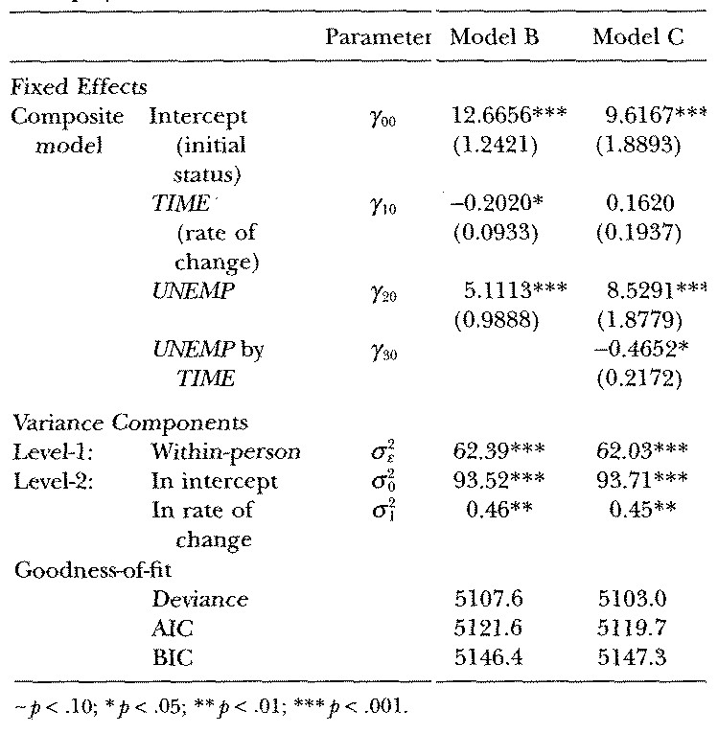
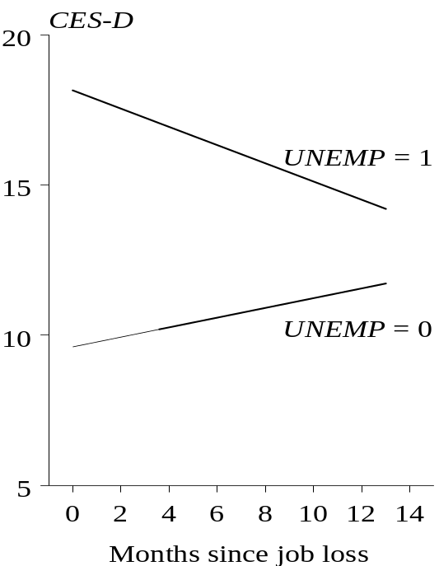
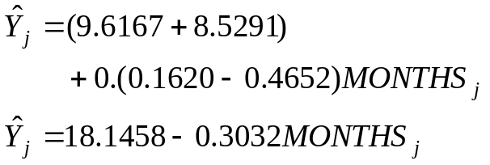

Model C: Allowing the effect of a TV predictor to vary over time
Main effect of TIME is now positive (!) & not stat sig ?!?!?!?!?!?!?!?!
UNEMP*TIME interaction is stat sig (p<.05)
Model B is a much poorer fit than C
(Δ Deviance = 4.6, 1 df, p<.05)
Consistently unemployed (UNEMP=1)
What about people who get a job?
Should the trajectory for the reemployed be constrained to 0?
Consistently employed (UNEMP=0)
(ALDA, Section 5.3.2, pp. 171-172)
© Singer & Willett, page <number>

Slide 23
How should we constrain the individual growth trajectory for the re-employed?
Should we remove the main effect of TIME? (which is the slope when UNEMP=0)
 Yes, but this creates a lack of congruence between the model’s fixed and stochastic parts
So, let’s better align the parts by having UNEMP*TIME be both fixed and random
 If we’re allowing the UNEMP*TIME slope to vary randomly, might we also need to allow the effect of UNEMP itself to vary randomly?
But, this actually fits worse (larger AIC & BIC)!
Model D:
UNEMP has both a fixed & random effect
UNEMP*TIME has both a fixed & random effect
What happens when we fit Model D to data?
(ALDA, Section 5.3.2, pp. 172-173)
© Singer & Willett, page <number>

Slide 24
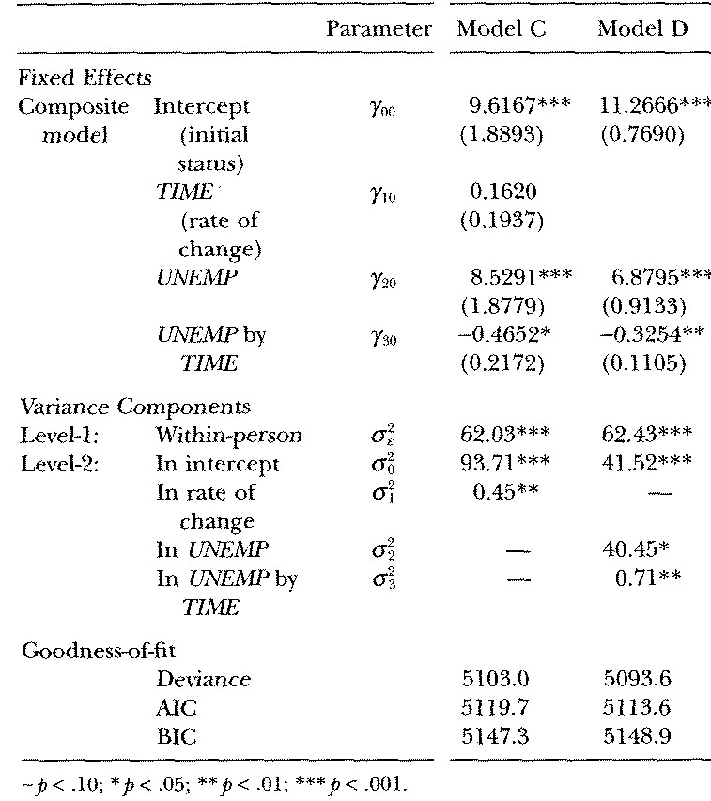
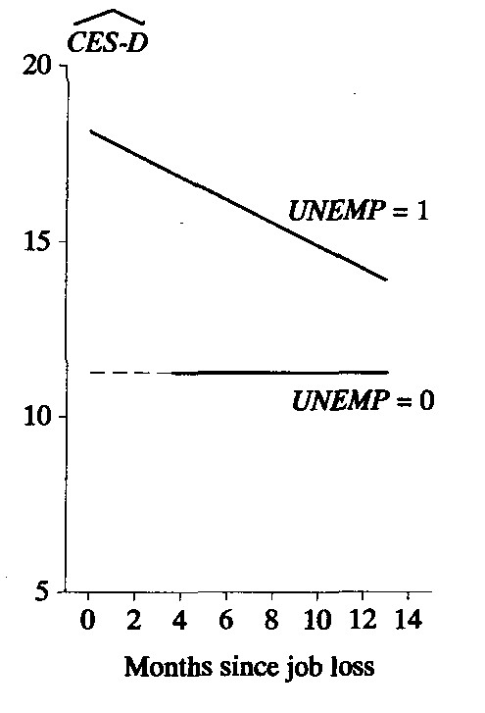
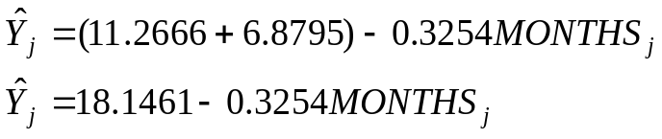

Model D: Constraining the individual growth trajectory among the reemployed
Consistently unemployed
What about people who get a job?
Best fitting model (lowest AIC and BIC)
Consistently employed
(ALDA, Section 5.3.2, pp. 172-173)
© Singer & Willett, page <number>

Slide 25

Recentering the effects of TIME
All our examples so far have centered TIME on the first wave of data collection
  Allows us to interpret the level-1 intercept as individual i’s true initial status
  While commonplace and usually meaningful, this approach is not sacrosanct.
We always want to center TIME on a value that ensures that the level-1 growth parameters are meaningful, but there are other options
  Middle TIME point—focus on the “average” value of the outcome during the study
  Endpoint—focus on “final status”
  Any inherently meaningful constant can be used
(ALDA, Section 5.4, pp. 181-182)
© Singer & Willett, page <number>

Slide 26


Example for recentering the effects of TIME
Data source: Tomarken & colleagues (1997) American Psychological Society Meetings
Sample: 73 men and women with major depression who were already being treated with non-pharmacological therapy
  Randomized trial to evaluate the efficacy of supplemental antidepressants (vs. placebo)
Research design
  Pre-intervention night, the researchers prevented all participants from sleeping
  Each person was electronically paged 3 times a day (at 8 am, 3 pm, and 10 pm) to remind them to fill out a mood diary
  With full compliance—which didn’t happen, of course—each person would have 21 mood assessments (most had at least 16 assessments, although 1 person had only 2 and 1 only 12)
  The outcome, POS is the number of positive moods
Research question:
  How does POS change over time?
  What is the effect of medication on the trajectories of change?
(ALDA, Section 5.4, pp. 181-183)
© Singer & Willett, page <number>

Slide 27
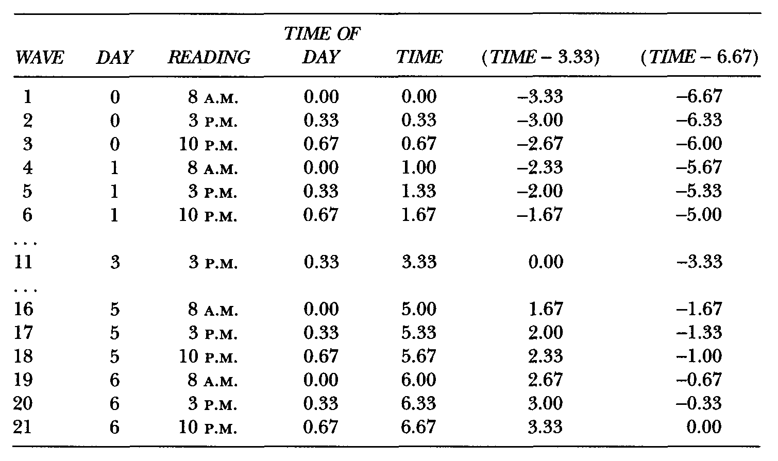
How might we clock and code TIME?
DAY—Intuitively appealing, but doesn’t distinguish readings each day
TIME OF DAY—quantifies 3 distance between readings (could also make unequal)
(TIME-3.33)
Same as TIME but now centered on the study’s midpoint
WAVE— Great for data processing—no intuitive meaning
READING—right idea, but how to quantify?
TIME—days since study began (centered on first wave of data collection)
(TIME-6.67)
Same as TIME but now centered on the study’s endpoint
(ALDA, Section 5.4, pp 181-183)
© Singer & Willett, page <number>

Slide 28
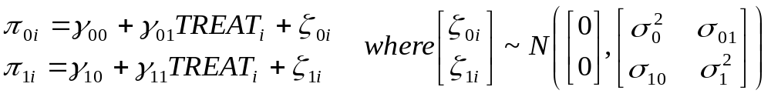



Understanding what happens when we recenter TIME
Instead of writing separate models depending upon the representation for TIME, let use a generic form:
Level-1 Model:
Level-2 Model:
Notice how changing the value of the centering constant, c, changes the definition of the intercept in the level-1 model:
When c = 0:
π_{0i} is the individual mood at TIME=0
Usually called “initial status”
When c = 3.33:
π_{0i} is the individual mood at TIME=3.33
Useful to think of as“mid-experiment status”
When c = 6.67:
π_{0i} is the individual mood at TIME=6.67
Useful to think about as “final status”
(ALDA, Section 5.4, pp 182-183)
© Singer & Willett, page <number>

Slide 29
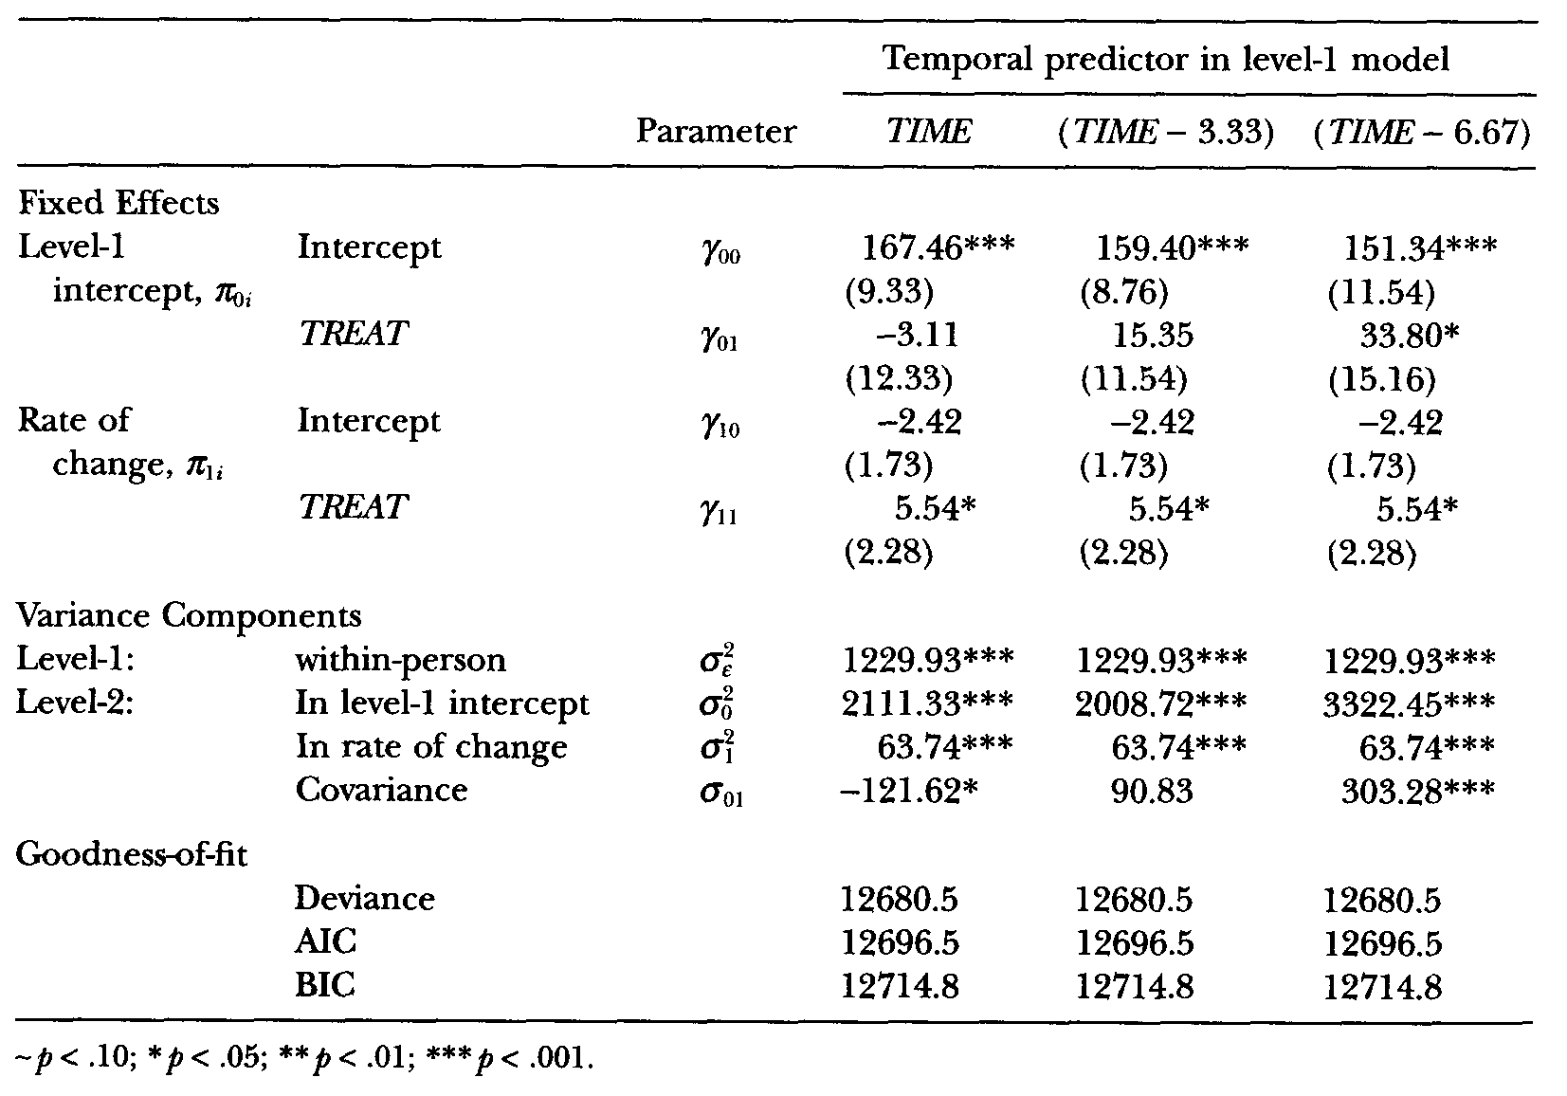


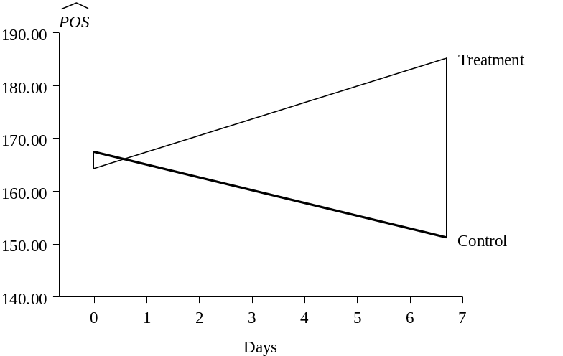
Comparing the results of using different centering constants for TIME
What are affected are the level-1 intercepts
assesses level of POS at time c for the control group (TREAT=0)
assesses the diff. in POS between the groups (TREATment effect)
-3.11 (ns) at study beginning
15.35 (ns) at study midpoint
33.80 * at study conclusion
The choice of centering constant has no effect on:
Goodness of fit indices
Estimates for rates of change
Within person residual variance
Betw person res variance in rate of change
(ALDA, Section 5.4, pp 183-186)
© Singer & Willett, page <number>

Slide 30
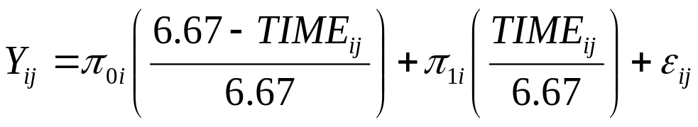
You can extend the idea of recentering TIME in lots of interesting ways
Example: Instead of focusing on rate of change,
parameterize the level-1 model so it produces one parameter for initial status and one parameter for final status…
Individual
Final Status
Parameter
Individual
Initial Status
Parameter
Advantage: You can use all your longitudinal data to analyze initial and final status simultaneously.
(ALDA, Section 5.4, pp 186-188)
© Singer & Willett, page <number>

